Slide 1
June 10/11 2021 - Virtual Conference
If you don’t train, you can’t blame!
Sharon Lambert
EMEA Partner Sales Enablement Manager
@ Adobe

Slide 2
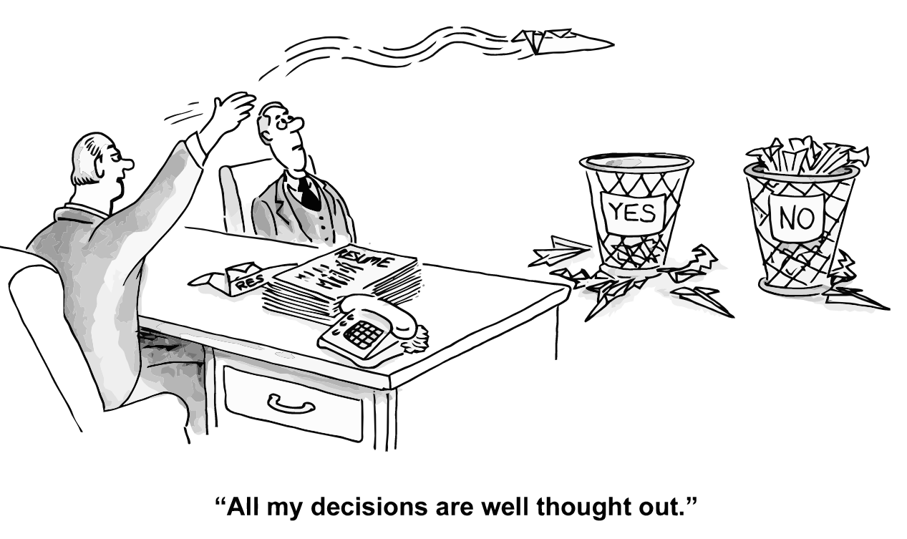
Knowledge
If you don’t train, you can’t blame!
Notes:
Are all the decisions we make well thought out? Maybe, maybe not always but it really helps if you have good knowledge!

Slide 3
The Perception
If you don’t train, you can’t blame!
Notes:
One of things that happens is that we see everything working out perfectly

Slide 4
Reality
If you don’t train, you can’t blame!
Notes:
The reality is often very different with rising frustration setting in when we realize the mountain we have to climb and things start to go wrong..

Slide 5
Unreal Expectations
If you don’t train, you can’t blame!
Notes:
Are the expectations of what we are asking our employees to do realistic?
SMART
Do they have the capabilities, the level of knowledge, the experience, the skills to perform that to the desired standard? If they fail, it is not their fault, it is our fault, we have failed to equip them for the task ahead.

Slide 6
Untrained staff
Slow Time to Value
Increasing Costs
Unrealized Goals
Demotivation
Dissatisfied Clients
High Turnover
Costly Mistakes
Failed projects
If you don’t train, you can’t blame!
Notes:
Lack of knowledge can result in loss of business, errors, reputation damage and lots more
Lack of knowledge can result in extra dependency on IT and operating costs – if you don’t train your business users how to set a promo, how to add products manage the catalog, they end up depending on the tech teams. Not want either teams want
Lack of knowledge – bad practices, short cuts, inefficient use of product solutions preventing your org from achieving business goals, can’t attract talent

Slide 7
Burn Out
If you don’t train, you can’t blame!
Notes:
Demands, deadlines and pressure
We are all human and it can destroy a person’s self confidence, self- belief and self-worth to fail or feel under valued which is what happens when we ask for items, project deliverables, without equipping those people to succeed.
How many times have you seen someone be promoted to a managerial position because they are so good at what they do? Then we put them in a role they are completely unprepared for, need a completely different skill set and yet expect the same results.
It’s the same with our teams.

Slide 8
Successful Companies Enable Their Teams
The company has properly onboarded their teams
Faster, more successful solution implementation
Teams that have skills and knowledge to run post-implementation boost sales revenue for their organizations
Business goals are achieved, and the bottom line is improved
Increased productivity
Higher profit margins
Higher income per employee
If you don’t train, you can’t blame!
Notes:
The people in your company are aware of Adobe Commerce and Magento OS and how it improves the business
They can confidently position Magento to your customers
They can complete project goals
Higher motivation levels
Reduced attrition
Easier to retain and attract talent through a developmental programme and you mazimize performance and investment
Drive digital maturity from adoption to optimization

Slide 9
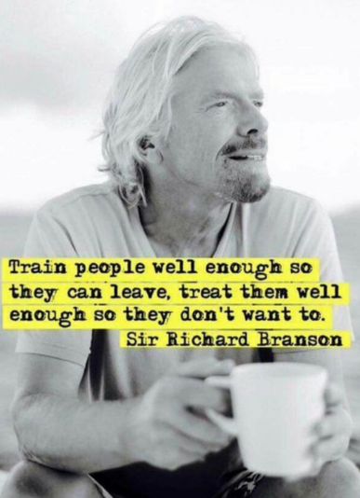
Training isn’t just about making sure the team has the right skills, it’s about your commitment to them, investing in their development, retention and much more

Slide 10
Learning Options - Developers
Magento 2 Front End Developers
Requirements Discovery in Adobe Commerce
Magento 2 Development Essentials
Adobe Commerce Cloud for Developers
If you don’t train, you can’t blame!
Notes:
Other providers in the eco-system like Swift Otter – prep courses and materials
Front End Devs – 3-day ILT – how themes work, set up, extend core functionality to create an effective storefront, templating system, use of LESS, Magento UI library components – basic intro to PWAs, JS, Page Builder Tool and other tools integrated into Magento USD 2,700
Requirements Discovery
effective strategies and best practices for gathering Magento Implementation requirements. Using real-world scenarios gleaned from experience by Magento s Professional Services group, you’ll learn how to write user stories and use cases to collect requirements through a Magento-focused lens. You’ll also be provided with tools and templates created by the Magento team to document your user stories, use cases, and system diagrams – 2 3hour sessions 900USD
Dev Essentials
Devs new to Adobe Commerce - perform simple Magento customizations using Magento techniques, dependency injection (DI), the layout system, action classes, installing/updating database schema, the web API, and more. This course aligns to preparation for the Adobe Certified Professional Developer - 5-hours over 8 days USD 4,700
Commerce Cloud for Devs
instructor-led online course where you will learn Cloud development best practices focusing on troubleshooting and integrations. Gain the skills to deploy, test, troubleshoot, and operate in the Cloud environment while enhancing your project operations and performance
5 hours x 4 days- 2,700USD

Slide 11
Learning Options – Business Users
Requirements Discovery in Adobe Commerce
Manage Your Adobe Commerce Catalog
Managing Your Adobe Commerce Store
Magento Business Intelligence
Adobe Digital Learning Services | Training & Certification
If you don’t train, you can’t blame!
Notes:
MBI – Documentation for merchants and tutorials for MBI to help manage your Magento data – info for data users, data analysts, admins, best practices, tutorials as well as installation info
MYM2S – 5 days x 5 hours (2,700 USD)
learn the basic information needed to set up and manage a Magento 2 store.
After completing this course, you will be able to: • Set up and manage your catalog, including category structure, product types, using layered navigation, multiple inventory sources, and product relations • Manage customer accounts and groups • Set up and use tax rules, payment and shipping methods, store emails, and reports • Create and manage orders, invoices, shipments, and credit memos • Create and manage content including blocks, widgets, and category landing pages
MYM2 CATALOG 5 days x 5 hours (2,700 USD)
learn to set up an effective structure and framework for displaying and operating your catalog. Students will also gather decision criteria and see the impact these decisions have on performance, cost of operations and the customer experience. Advanced hands-on exercises will benefit new and experienced business users

Slide 12
Adobe Commerce All Access Learning Subscription
Magento Security for Developers OD
Getting Started with JavaScript OD
Front End Core Concepts for Developers OD
Commerce Cloud for Developers OD
Page Builder for Business Users OD
Managing Your Magento 2 Store OD
Fundamentals of Magento Development v2.3 OD
B2B for Business Users OD
If you don’t train, you can’t blame!
Notes:
5000 USD one individual 12 months access to every course OD and ILT – ONLY GET ACCESS TO THESE COURSES THROUGH Subscription ALL ACCESS PASS or SPP if partner
Magento Security for Devs - Learn to securely deploy Magento 2 projects. With the rise of global fraud and data breaches, security has become a priority for Ecommerce platform. Gain the knowledge of security best practices and protocols to minimize the risk of data breach and payment fraud. This course will familiarize you with security best practices to enable you to support your development team working with the Magento 2 platform.
Page Builder
his course teaches Page Builder functionality by providing an overview of the tool and introducing real-life scenarios with their solutions. Students will create and revise content with Page Builder, receive an introduction to the Design System concept, and receive tips for working with your team to customize Page Builder to your brand. This course contains many follow-along exercises and a lab to test your new skills. This course will be beneficial for new and experienced Magento users who create content rich pages using Magento v2.3.1 and above.
B2B
This course provides an overview of the Magento B2B features, including an introduction to setting up and configuring catalogs. It covers setting up company information for B2B partners which includes identifying financial information such as credit and payment methods, B2B partner roles such as company admin and purchasing team, and permissions such as controlling access to B2B orders and quotes. It walks through the B2B storefront purchasing experience and backend order process. It also covers the B2B purchasing and checkout processes including methods of placing orders, requesting and issuing quotes, using purchase orders, reordering, viewing credit balances, and tracking purchases. This course is based on Magento Commerce 2.3.x.

Slide 13
Hero title
Use this slide to strenghten a message
If you don’t train, you can’t blame!

Slide 14
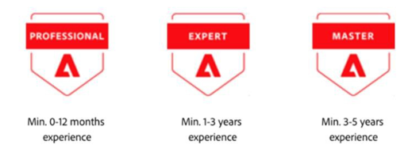
Certifications
Certification increases your earning potential
Differentiator
Demonstrates your ability to customers that you have the desired skills and real-world experience for the project
Certifications are an essential criteria for becoming Specialized as a Partner organization
If you don’t train, you can’t blame!
Notes:
Pair new employees up with a buddy
Have a mentor
Let them work on projects and be involved
Develop Magento Masters who are experts in …. Your go to person
When people join your organization – develop a plan for them so they are progressing towards certification and skills mastery

Slide 15
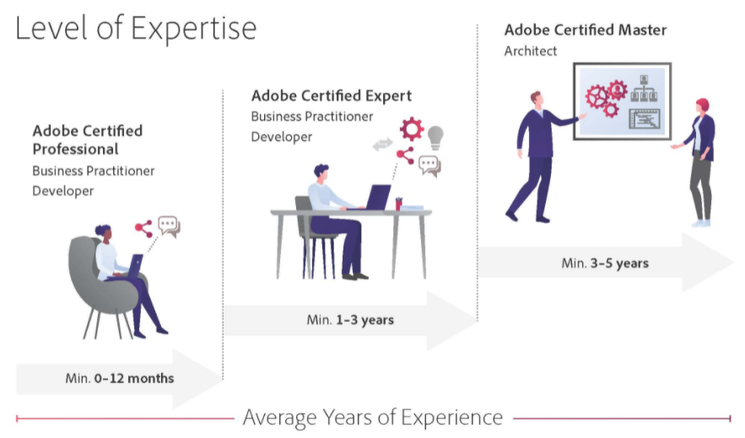
Adobe Commerce Certifications
Certification | Adobe Digital Learning Services
Notes:
Professional 0-12 months of learning and work exp – Business Practitioner and Developer Roles
Certified Expert 1-3 years of project experience working independently on challenging projects – Business Practitioner and Developer Roles
Adobe Certified master – Min 3 years solution experience, leading complex projects, mentors others. Available for Architect Role and you must hold the Adobe Certified Expert developer to qualify
Study Guides
Mock exams

Slide 16
Adobe Commerce Certification Benefits
Gain loyalty by investing in your team
Attract and win new business
Validate technical skills and expertise
Stand out and differentiate yourself
Leverage the power of the Adobe brand
Increase your earning potential

Slide 17
Hero title
Use this slide to strenghten a message
If you don’t train, you can’t blame!

Slide 18
Credentialling Volunteer Opportunities
Adobe Commerce Business Practitioner Expert
The purpose of this Item Writing Workshop is to create and review item content (questions) for the Adobe Commerce Business Practitioner Expert Certification Exam.
When: June 14-17 (SMEs will receive their item writing and review schedule on June 17th)
Where: Virtual Workshop
In recognition of your participation, Adobe will provide several amazing benefits!
Badge signifying you as an Adobe Subject Matter Expert
Credit for passing the exam to which you contribute – no need to take the exam
One Adobe virtual Instructor Led Training (average retail value $2,700)
A one-year subscription to Adobe Creative Cloud (retail value $1,200) (first time non-Adobe SMEs only)
One Adobe Certification exam voucher (retail value $180)
For more information, please contact Ayana Nickerson (anickers@adobe.com)
If you don’t train, you can’t blame!
Notes:
Approx 90 mins x 3 plus time to review outside of these sessions to be completed for final review with all SMEs 29 June and July 1

Slide 19
Resources
Magento User Guide (2.4 Magento Admin)
Planning and Budgeting for Magento Commerce Upgrade Cycles
Installation Guide
Upgrade Guide
The Magento Community Hub
If you don’t train, you can’t blame!
Notes:
Other providers in the eco-system like Swift Otter – prep courses and materials

Slide 20
10 e 11 giugno 2021 - Virtual Conference

